Slide 1
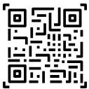
YOUR DAILY PAYMENTS ARE NOW MADE EASY
-by Jatin Chauhan
+NOW MAKE PAYMENTS THROUGH YOUR SMARTWATCH

Slide 2
NO NEED TO CARRY YOUR WALLET NOW
YOUR DAILY PAYMENTS ARE MADE EASY

Slide 3
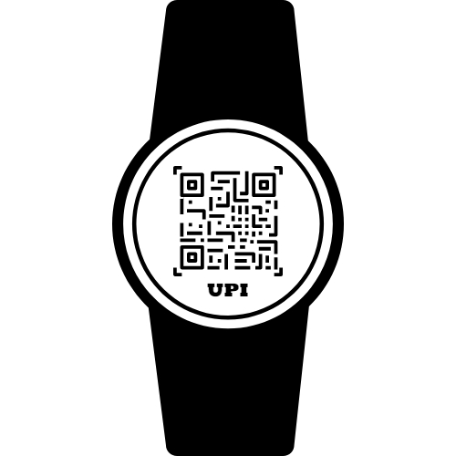
JUST SHOW YOUR UPI QR-CODE TO MERCHANT AND YOUR PAYMENT IS DONE

Slide 4
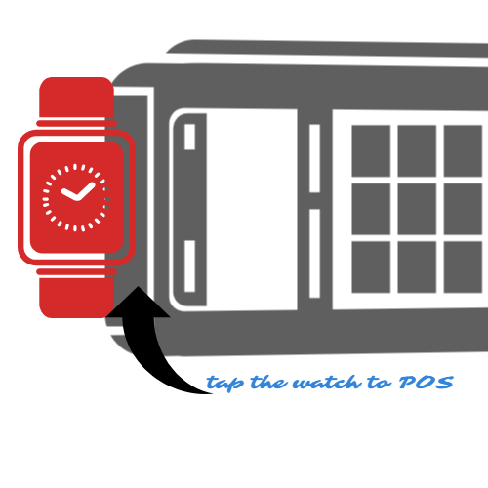
JUST TAP YOU WATCH TO POS MACHINE AND YOUR PAYMENT IS DONE

Slide 5
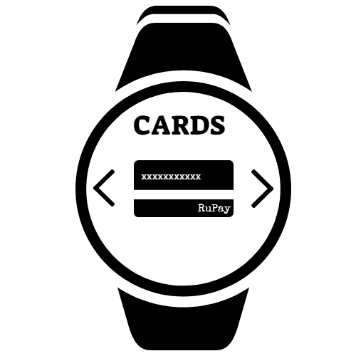
NO NEED TO CARRY YOUR’S CARDS EVERYWHERE
USER CAN HAVE MULTIPLE VIRTUAL CARDS IN HIS WATCH FOR DOING PAYMENTS
USER CAN SCAN DOCUMENTS AND CARDS(PAN CARD/DRIVING LICENCE/OFFICE & SCHOOL ID-CARDS) KEEP THEM IN THEIR WATCH.

Slide 6
User don’t have to carry Debit Cards, Credit Cards, Adhar-Card(SSN in US), Driving Licence, PAN Card, Parking card, Identity Card , Toll Card & Shopping cards Anymore. All This would be in his watch.

Slide 7
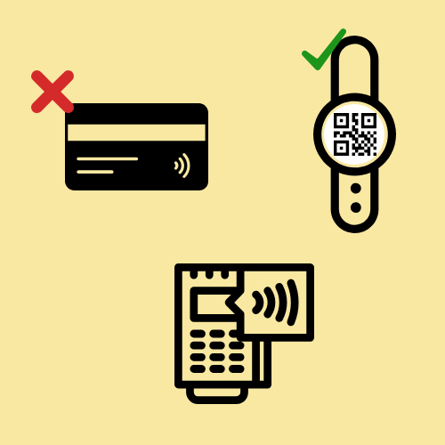
TIME TO BE SMART

